Slide 1
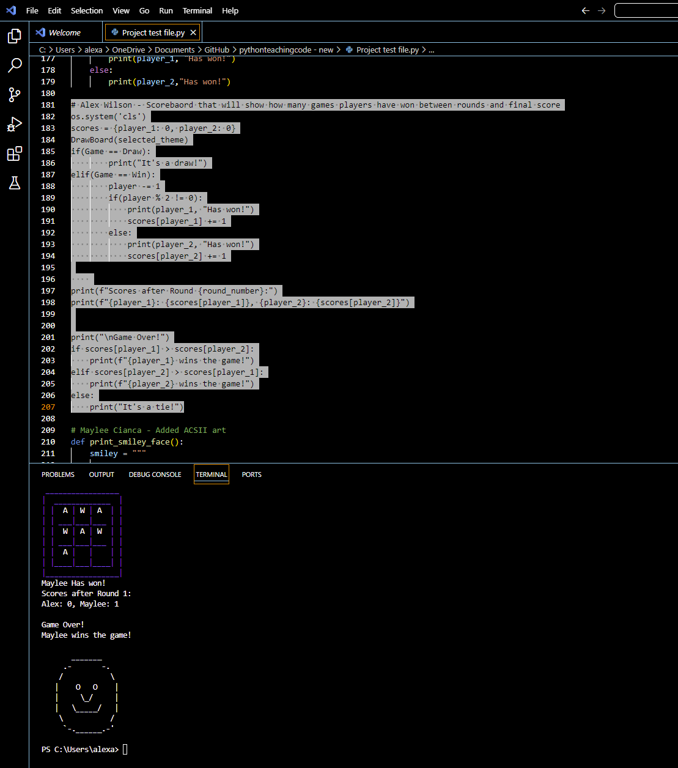
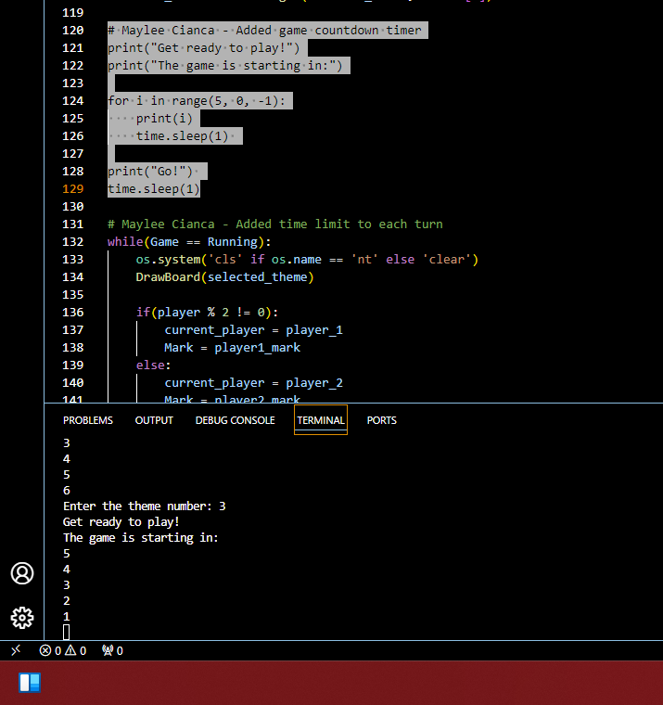
Codes and Crosses
Created by: Alex Wilson and Maylee Cianca
Think Fast, Play Smarter: Tic-Tac-Toe with a twist!

